Slide 1
Management 515
Effective Groups and Teams
© 2014, 2016 David E. Frick.
All rights reserved.

Slide 2
Definitions
Group. Two or more people who interact with each other to accomplish certain individual or group goals or meet certain individual or common needs
Team. A group whose members work intensely and interdependently to achieve a specific, common goal or objective where all members have some responsibility for outcomes
Notes:
Two characteristics distinguish teams from groups.
--Intensity with which members work together.
--Presence of a specific, overriding team goal or objective.
View: https://www.youtube.com/watch?v=0hV65KIItlE
In a team, one weak link can be disastrous. We will discuss shirking in a later lecture.

Slide 3
Advantages
Synergy
Ability of group members to compare ideas
Chance to correct each other’s mistakes
Brings diverse knowledge base to bear on a problem
Scope. Ability to accomplish work too vast for one person
Division of Labor
Assigning specialized work to those with the specific skills or talents
Takes advantage of economies of scale
Notes:
Division of labor is the separation of tasks so that workers may specialize. Specialized capabilities may include the use of equipment, skills, or training.
The division of labor is the motive for trade and the source of economic interdependence.
When workers perform single or limited tasks, it can eliminate long training periods required to train craftsmen, who can then be replaced with lesser paid but more productive unskilled workers.
Historically, an increasing division of labor is associated with the growth of total output and trade, the rise of capitalism, and the increasing complexity of industrialization.
See: https://www.youtube.com/watch?v=row3qYD7jL4

Slide 4
Teams and Innovation
Innovation. The creative development of new products, technologies, services, or organizational structures
Individuals seldom possess the wide variety of skills needed for successful innovation
Teams can compensate for individual flaws and balance individual strengths and weaknesses
Managers should make the team responsible for the process of innovation
Notes:
Managers must ensure teams have adequate resources, tools, information, and authority to complete the innovation process.
A project champion is essential.

Slide 5
Teams and Motivation
Members often perform better and are more satisfied with conditions in autonomous teams
Self Determination Theory
Equity Theory
Many people have personalities that are better suited for teams than individual performance
The converse is also true. Some people are loners.
Notes:
Self determination theory: https://www.youtube.com/watch?v=MZmTALSbthM
You should have already viewed the video for Equity Theory (week 1).
With respect to passion in your work, I encourage you to watch a TED talk by Mike Rowe (of the show Dirty Jobs). https://www.youtube.com/watch?v=IRVdiHu1VCc
I believe it well worth the 20 minute investment. Nonetheless, I believe the moral of his story is that the adage, “follow your passion” is not a recipe for success. The recipe is find (or trip over) something that you at good at and work hard.

Slide 6
Types
Informal
Friends
Interest groups
Formal
Cross-functional
Cross-cultural
Virtual
R&D
Task forces
Manage-ment
Notes:
A cross-functional team is a group of people with different functional expertise working toward a common goal. Typically, it includes employees from all levels of an organization. Members may also come from outside an organization (in particular, from suppliers, key customers, or consultants).
Cross-cultural teams gather persons from different cultures to tackle problems that may benefit from widely varied views and perspectives.
A virtual team (also known as a geographically dispersed team, distributed team, or remote team) is a group of individuals who work across time, space, and organizational boundaries with links strengthened by communication technology media.
Research and develop (R&D) teams are form specifically to explore new technologies, techniques, and sciences.
Task forces are teams that are formed to meet an immediate, temporary need, usually problem solving.

Slide 7
Keys to Effective Self-Managed Teams
Give the team enough responsibility for the task to be meaningful
Give the team sufficient autonomy and authority to be self-managing. A task champion is vital
Select members carefully. Diversity of skills, thought, enthusiasm, and ability
Manager should guide and coach, not supervise
Ensure the team has the proper training to complete the task
Notes:
A common mistake in management is the tendency to assign responsibility, but fail to delegate the appropriate level of authority necessary to fulfill the responsibility.
Enthusiasm is a great thing, but you do not want the team to burn out. A good team leader is aware of how much is asked of the team and how much it can possibly deliver.
Ability—not all tasks need top performers. Assigning tasks to inexperienced or lower performing workers can be a cost saver.

Slide 8
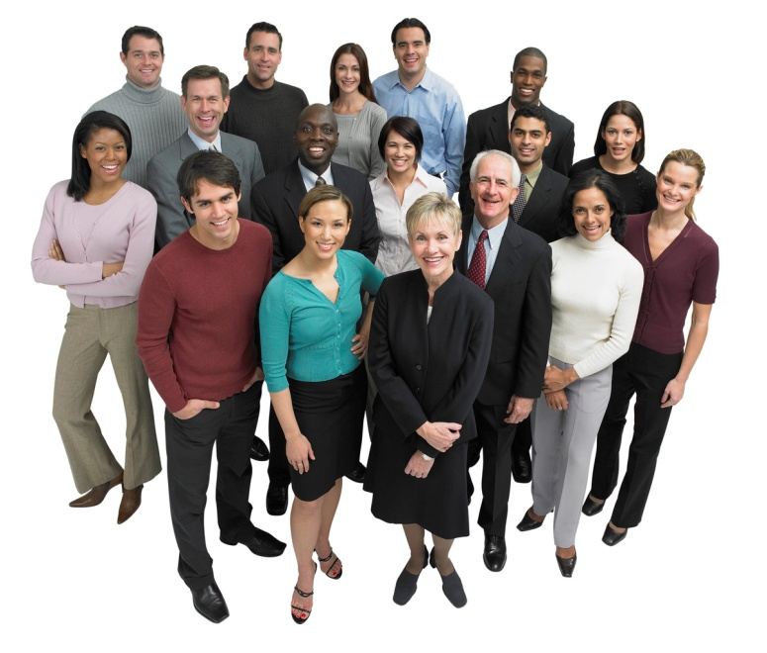
Relationships
Does Sally get along with Frank?
Is Tom in a personal relationship with Mary?
Will Bill trust Henry’s judgment?
That is a lot to manage…
Notes:
The size of the team is directly proportional to the complexity of communication and likelihood of conflict.
If the team is only Mary and Sam, then only one relationship that may affect the quality of the teamwork exists. When you add Frank, we have Mary => Sam, Mary => Frank, and Frank => Sam for three. Add Sally and we are up to six, and so forth. Any one of these relationships can create conflict within the team.

Slide 9
Advantages of a Small Group
Fewer relationships means more opportunity for full interaction among team members
Easier to share information
Easier to see the effects of personal contributions
Less opportunity for shirking or social loafing

Slide 10
Social Loafing
Social Loafing. The tendency of individuals to put forth less effort in a group than individually
Results in lower group performance
Reducing social loafing:
Make individual efforts identifiable and accountable
Emphasize value of individual contributions
Keep group size at appropriate level
How would you reduce social loafing?
Notes:
Social loafing refers to the concept that people are prone to exert less effort on a task if they are in a group versus when they work alone. The idea of working in groups is typically seen as a way to improve the accomplishment of a task by pooling the skills and talents of the individuals in that group. But, in some groups, there is a tendency on the part of participants to contribute less to the group's goal than if they were doing the same task themselves.
Consequences of Social Loafing. Social loafing has negative consequences for both the group and the individuals in the group. The group dynamic is affected when certain individuals are seen as weak contributors to the group purpose. It tends to split the group and fosters a lack of cohesion.
What Promotes Social Loafing?
1. Group Size: The larger the group, the more likely it is that social loafing will occur. For example, if you have ten members of a group working on a project, it is easier for individuals who are not motivated or productive to hide because there are more people to pick up the slack.
2. Low Levels of Motivation: An absence of individual motivation prompts poor group participation. A member might question the alignment of the member’s goals with the group's goal. If a member doesn't think the group's purpose is worth the commitment of time or energy, performance will be low.
3. Reduced Sense of Contribution. If an member does not feel his or her contribution matters, effort will likely be lessened. A good example of this is voting. Many people say vote for a cause you believe in, but, if you perceive that too many people will vote against your cause and your cause will lose with or without your vote, you may choose not to participate.

Slide 11
Advantages of a Large Group
More resources to accomplish the goal
Greater opportunity for division of labor
Potential for more diversity of thought, skills, and knowledge

Slide 12
Group Roles
The sets of behaviors that individual members assume because of position, personality, or cultural norm
Both formal and informal
Informal roles can be extremely useful or destructive
Groups the evolve independently often have informal leaders irrespective of formal assignments
Notes:
The next two pages list some of the personalities that you are likely to meet in a group.
Dealing with each of these types is beyond the scope of this class, but expect to see one or more of these on quizzes or extra credit.
Note that groups commonly have two leaders, the formal leader (the person assigned to lead the group by senior management) and an informal leader (any member of the group who stands up and inspires others to perform).

Slide 13
Group Dynamics
Role | Characteristics
Latecomer | Always comes late to meetings. Insists on stopping the group to catch up.
Early Leaver | Drains group's energy and morale by leaving meeting before its end.
Broken Record | Brings up the same point repeatedly. Can prevent the group from moving ahead.
Head Shaker | Actively expresses disapproval through body language. Tries to influence group to reject ideas.
Dropout | Sits away for the table. Expresses disapproval by ignoring proceedings. May read or do unrelated work.
Whisperer | Constantly whispering during meetings. Upstages session leader and other group members.
Loudmouth | Talks too often and loudly. Dominates discussions. Impossible to shut up.

Slide 14
Role | Characteristics
Attacker | Launches verbal, personal attacks on group members. Constantly ridicules ideas of others.
Interpreter | Always speaks for someone else, usually without invitation. Restates, but distorts the ideas of others.
Gossiper | Brings hearsay or rumors into the conversation. Claims additional power because of this exclusive knowledge.
Know-it-All | Uses credentials, age, seniority to argue a point. Argues that opinion is correct because of status.
Backseat Driver | Attempts to control meeting by disparaging the work or opinion of session leader.
Busybody | Always ducking out of meetings. Takes calls or other interruptions. Presents the image of someone too busy to be bothered with the task at hand.
Interrupter | Jumps into discussion and cuts off debate. Concerned that own ideas will not be considered.
Teacher's Pet | Spends time and energy seeking leaders approval. Seldom contributes.

Slide 15
Tuckman’s Model
Continue work and battle for status
Majority of work and conclusion
Forming
Storming
Norming
Performing
Learn about the task and each other
Establish acceptable behavior
Adjourning
Group disbands
Notes:
Here is Tuckman’s model.
The Forming – Storming – Norming – Performing model of group development was first proposed by Bruce Tuckman in 1965, who maintained that these phases are all necessary and inevitable in order for the team to grow, to face up to challenges, to tackle problems, to find solutions, to plan work, and to deliver results. This model has become the basis for subsequent models.
In 1977, with the second edition on his book, Tuckman added the Adjourning step, claiming that all groups eventually disband.

Slide 16
Five Stages
Forming. Group members get to know each other and reach common understanding and language
Storming. Group members experience conflict because some members do not wish to submit to demands of other group members
Norming. Consensus and person relationships develop
Performing. The group begins to do its real work
Adjourning. The group disperses
Notes:
Forming. The team meets and learns about the opportunities and challenges, and then agrees on goals and begins to tackle the tasks. Team members tend to behave quite independently. They may be motivated but are usually relatively uninformed of the issues and objectives of the team. Team members are usually on their best behavior but very focused on themselves. Mature team members begin to model appropriate behavior even at this early phase.
The forming stage of any team is important because the members of the team get to know one another, exchange some personal information, and make new friends. This is also a good opportunity to see how each member of the team works as an individual and how they respond to each other. So forming plays a great role in group forming and to understand each other's behavior.
Storming. Tolerance of each team member and their differences should be emphasized; without tolerance and patience the team will fail. This phase can become destructive to the team performance will be lower if allowed to get out of control. Some teams will never develop past this stage; however, disagreements within the team can make members stronger, more versatile, and able to work more effectively as a team. Supervisors of the team during this phase may be more accessible, but tend to remain directive in their guidance of decision-making and professional behavior. The team members will therefore resolve their differences and members will be able to participate with one another more comfortably. The ideal is that they will not feel that they are being judged, and will therefore share their opinions and views. Normally tension, struggle and sometimes arguments occur.
Norming. In this stage, all team members take the responsibility and have the ambition to work for the success of the team's goals. They start tolerating the whims and fancies of the other team members. They accept others as they are and make an effort to move on. The danger here is that members may be so focused on preventing conflict that they are reluctant to share controversial ideas.
Performing. By this time, they are motivated and knowledgeable. The team members are now competent, autonomous and able to handle the decision-making process without supervision. Dissent is expected and allowed as long as it is channeled through means acceptable to the team.
Supervisors of the team during this phase are almost always participating. The team will make most of the necessary decisions. Even the most high-performing teams will revert to earlier stages in certain circumstances. Many long-standing teams go through these cycles many times as they react to changing circumstances. For example, a change in leadership may cause the team to revert to storming as the new people challenge the existing norms and dynamics of the team.

Slide 17
Group Norms
Group norms. Shared guidelines or rules of behavior that most of the group follows. May contradict organizational rules leading to ethical or legal violations
Managers should encourage teams to develop norms that contribute to group performance and achieving goals
Conformity and deviance.
Members conform to norms for personal reasons (Rational Economic Maximizing Individual (REMI))
Members deviate from norms for personal reasons, but other members try to make them conform, expel the deviant, or change the group norms
Notes:
Review this Web page: http://2012books.lardbucket.org/books/an-introduction-to-group-communication/s05-05-group-norms.html

Slide 18
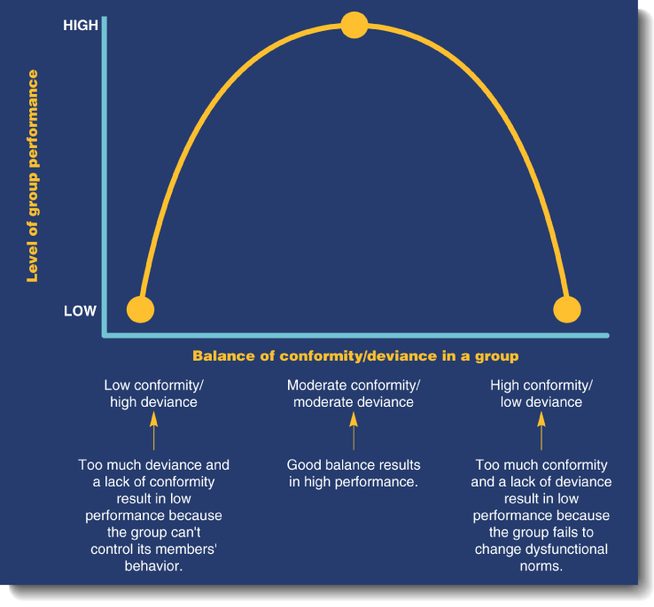
Conformity vs. Deviance
Notes:
“Normal is the average of deviance.” --Rita Mae Brown
You will see this concept many times in this course. The point is that, “some conflict must exist in a group for the group to perform at the highest level.” I cannot tell you where that point is on the curve, but clearly no conflict and total conflict are not the ideal points on the curve.

Slide 19
Group Cohesion
The degree to which members are attracted to their goals
Consequences
Level of participation
Level of conformity to group norms
Dedication to group goal achievement
Affected by:
Group size
Group identity
Healthy competition
Success
Notes:
Group cohesion is defined as the tendency for a group to be in unity while working towards a goal or to satisfy the emotional needs of its members. This definition can be generalized to most groups, including sports teams, work groups, military units, fraternity groups, and social groups. However, it is important to note that other researchers claim that cohesion cannot be generalized across many groups.
The bonds that link group members to one another and to their group as a whole are not believed to develop spontaneously. Over the years, social scientists have explained the phenomenon of group cohesiveness in different ways. Some have suggested that cohesiveness among group members develops from a heightened sense of belonging, teamwork, interpersonal and group-level attraction.

Slide 20
Motivating Groups
Members should benefit when the group performs well
Group extrinsic rewards
Individual extrinsic rewards
Team awards vs. group rewards
Leads to social loafing
May lead to ill feelings (Equity Theory)
Extrinsic rewards
Motivation Crowding Theory
Expectation Theory
Self-determination Theory
Others
⬅ Caution
Notes:
Almost all of the current books on management claim that extrinsic, contingency-based rewards are useful or even necessary to ensure high group performance. I disagree with the position. We will discuss this in greater detain in the lecture on motivation.
Review this video: https://www.youtube.com/watch?v=Wx6TBDMAsoo (Motivation Crowding)
Watch it all the way through. This concept will be addressed in a future quiz.

